Slide 1

Game Project
WEB 2022A-Module3

Slide 2
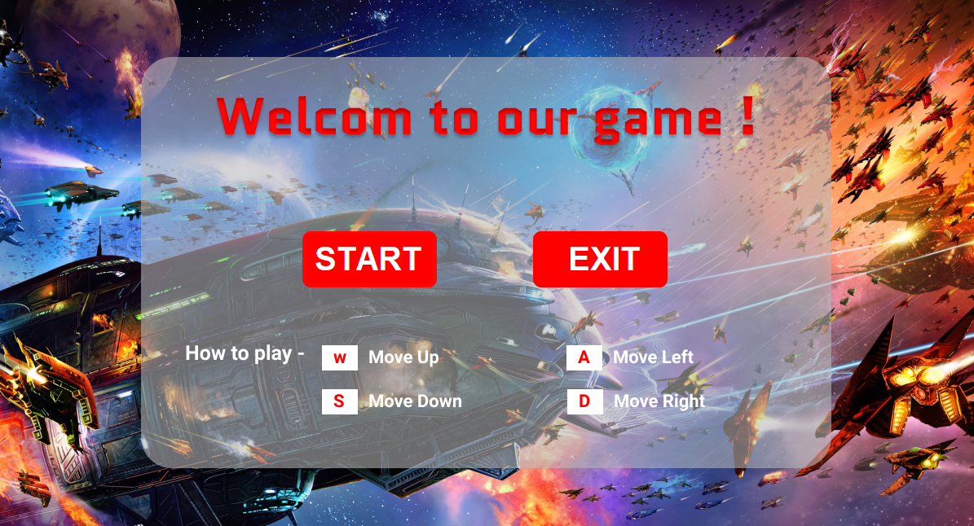
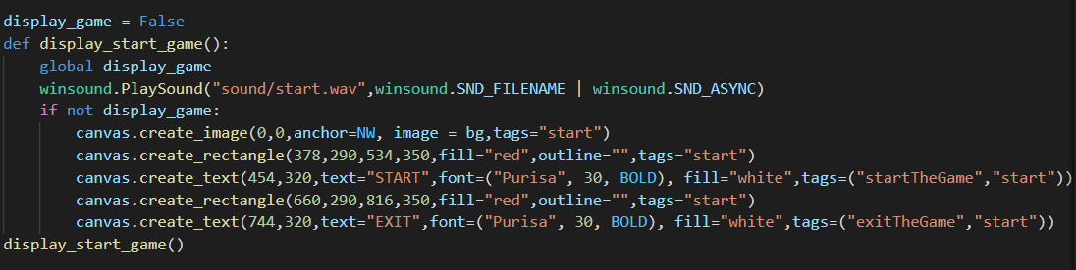
Mengyi
Create feature of the starting game

Slide 3
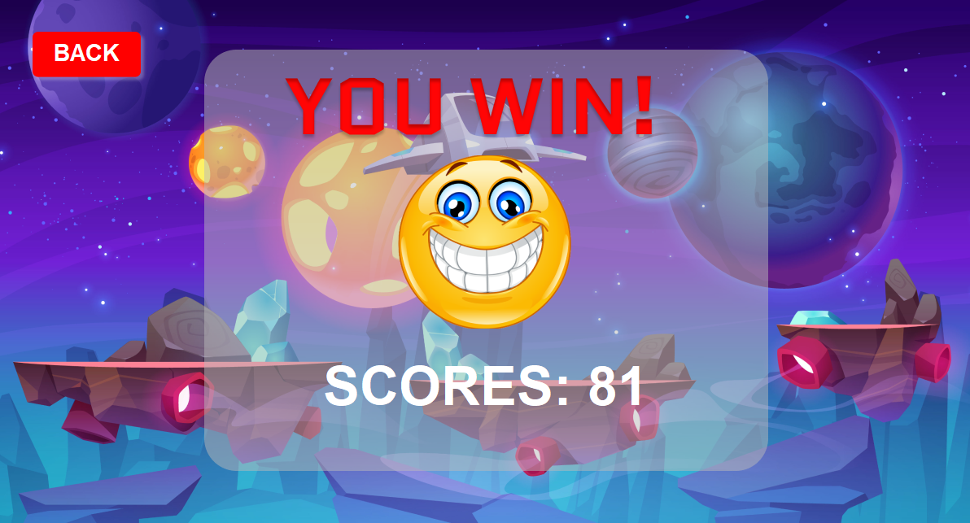
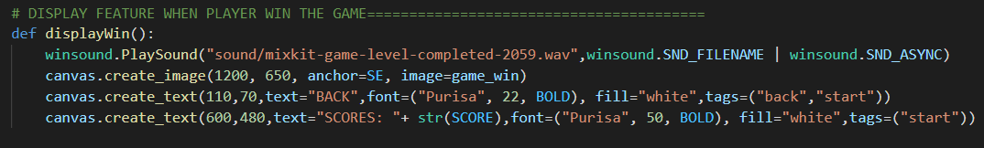
Mengyi
Create feature of the winning starting game

Slide 4
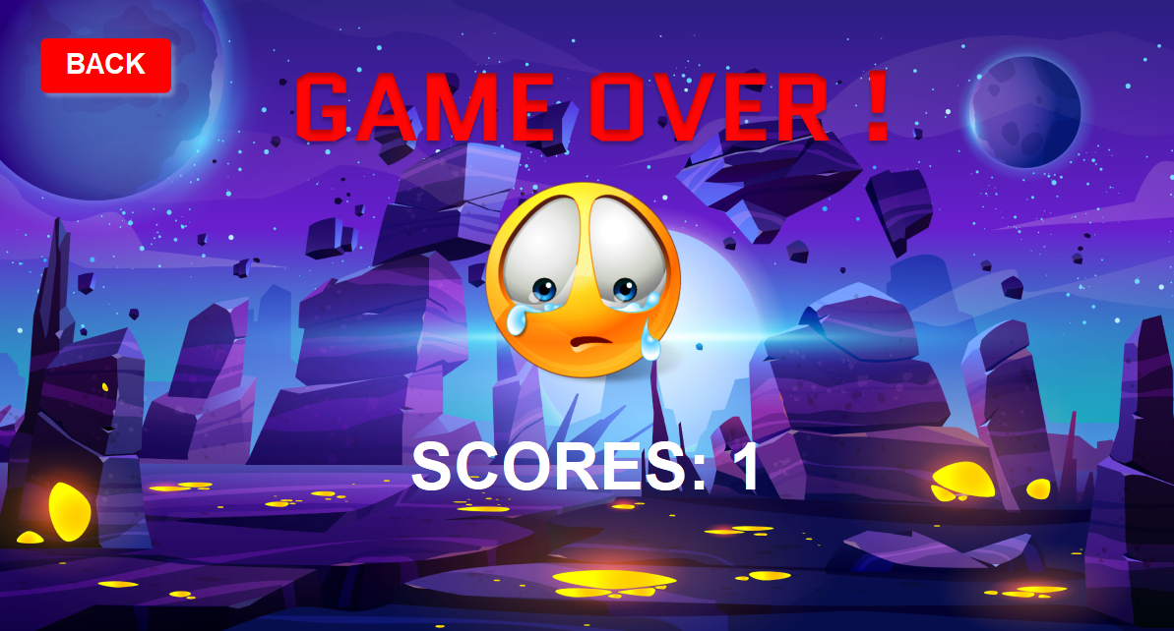
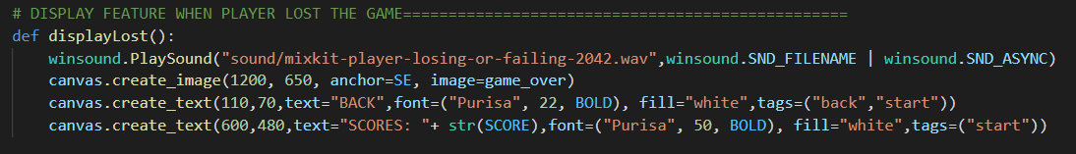
Mengyi
Create feature of the lost game

Slide 5
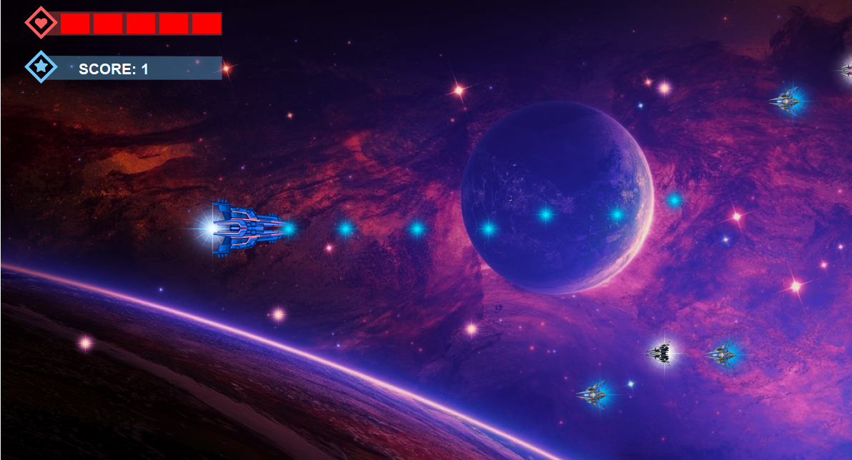
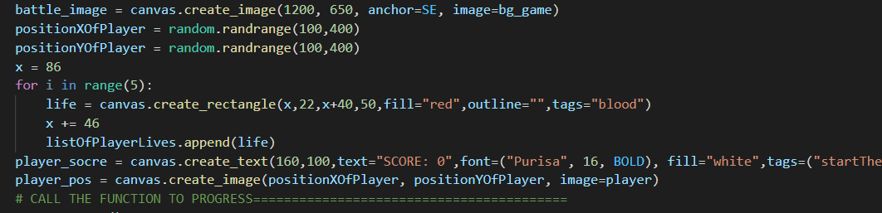
Sauth
Create player spaceship, score and blood

Slide 6
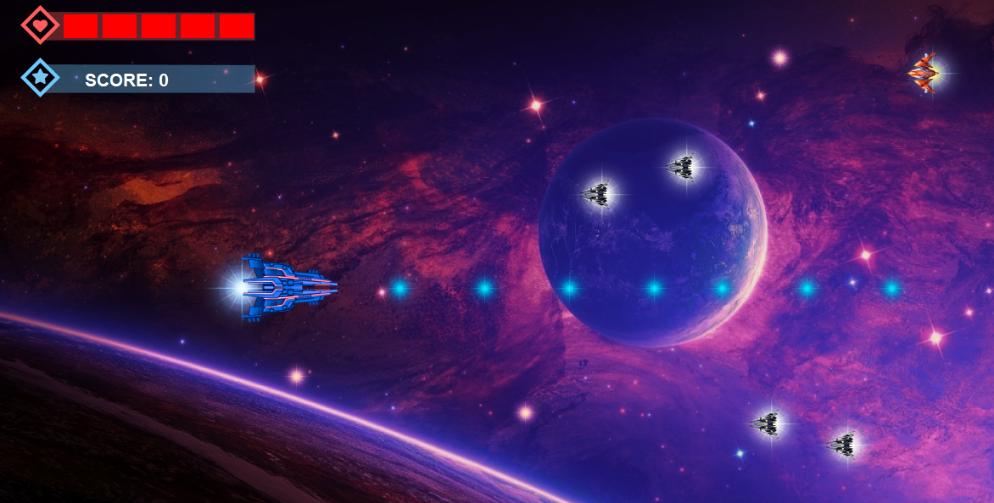
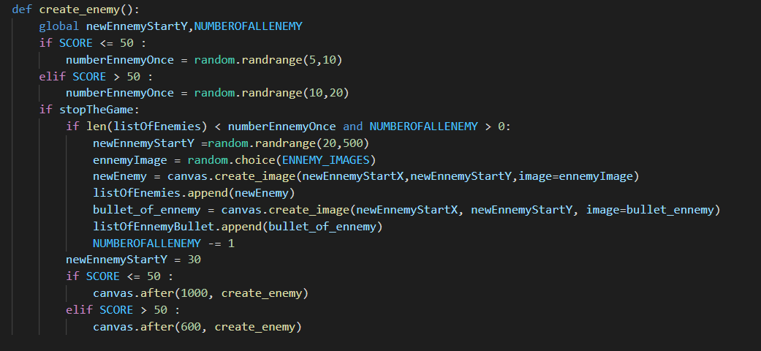
Sauth
Create Enemy and bullet

Slide 7
What we have learnt
Hard-Skill
Soft-Skill
Clear about how to use function
Team work
Using Tkinter library
Time management
Using code to create game
Problem solving
Researching
Making plan
Using concept algorithm
Designing feature of the game

Slide 8





Thank you !
www.passerellesnumeriques.org

